Slide 1
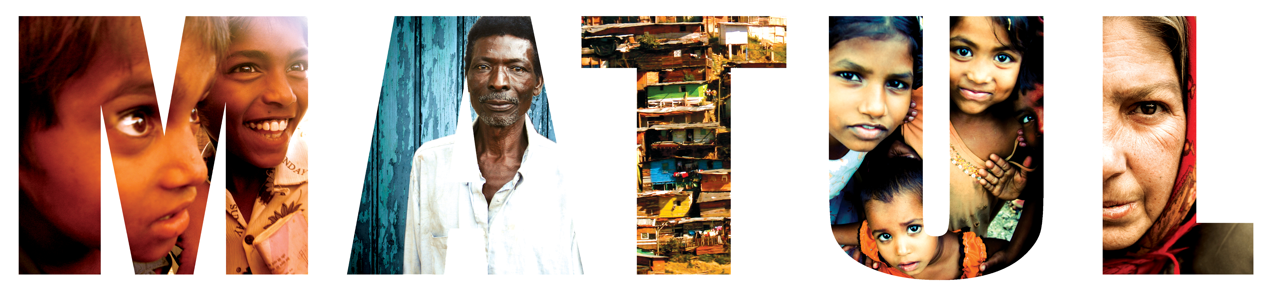
TRANSFORMATIONAL URBAN LEADERSHIP
Azusa Pacific University
Dr. Viv Grigg, International Director

Slide 2
Indian Urbanization
55% of India’s population live in cities
  10,000 people migrate into Chennai daily
  20,000 migrate to Mumbai daily.
The majority go to the slums
  35% in Chennai,
  45% of Mumbai
Rapid increase of slums
No Response?: Urban population keeps increasing but the ministry among the urban poor is decreasing.
Need to Change Focus: 80% of Christian organisations in India focus on the rural poor.

Slide 3
50,000 from the slums to the slums
God is doing this
How do we work with him?
  Grassroots training
  Leadership Training
  HBI began MATUL in 2007
    10 paying students
    Rs15,000 for the 2 year degree
    In 2008, 5
    In 2009, 9
    In 2010, 8
    Develop Promotional Team
    Most students are pastors from Pentecostal

Slide 4
HBI Process
Stay for 2 weeks modules, then 3 months out doing practical and studying
12 students graduated.

Slide 5
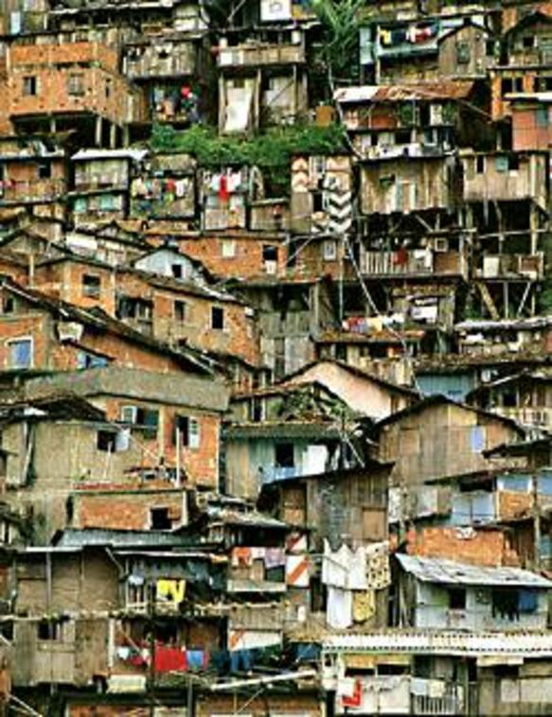
Dispossessed?
1.3 billion people around the globe living in slums, sidewalks, under bridges, on riverbanks, and in garbage dumps.
We need to be demonstrators of the Kingdom of God to the marginalized.

Slide 6
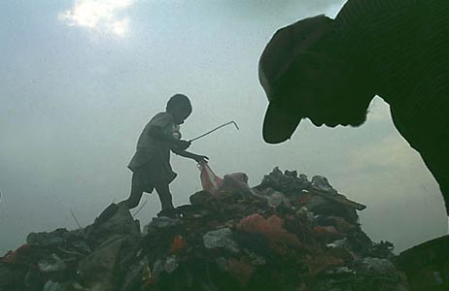
What is transformational urban leadership?
MOMENTUM
ENVISIONING
MOVEMENT LEADERSHIP
TEAM BUILDING
SPECIALIST EXPERTISE
Entrepreneurial leadership generates:
movements of poor people’s churches
economically engaged disciples
activists in the struggles for justice
critical catalysts in transforming the poverty
Picking garbage in Payatas

Slide 7
Jesus trained in action
DELIVERY
PROCESS
CHARACTER
AND
SPIRITUALITY
Each course 1/3 action, 1/3 theology, 1/3 social analysis

Slide 8
How Do You Learn Leadership?

Slide 9
YEAR 1
Semester 1 |  | Semester 2
TUL 500 | Writings, Reign and Urban Realities | TUL 540 | Urban Reality and Theology
TUL 505 | Language and Culture Acquisition | TUL 550 | Service to the Marginalized
TUL 520 | Urban Spirituality | TUL 555 | Educational Centre Development
TUL 530 | Building Faith Communities | TUL 560 | Theology & Practice of Community Economics
YEAR 2
Semester 1 |  | Semester 2
TUL 620 | Leadership in Urban Movements | TUL 640 | Entrepreneurial @ Organizational Leadership
TUL 630 | Community Transformation | TUL 655 | Advocacy and the Urban Environment
TUL 650 | Primary Health Care | TUL 670 | Research Project or Thesis

Slide 11
Community Outcomes
Community Outcomes
YEAR 1: Students and teams start a small group or ministry
YEAR 2: Students and teams start 3 small groups or ministries
YEAR 3: Continuation after graduation to establish a new faith community or specialist ministry

Slide 12
MATUL Learning Domains
Culture Studies
Urban Church Growth
Community
Transformation
Movement
Leadership
Urban Spirituality
and Theology
Small Business and Organizational Development
Specialist Disciplines: Slum Schools, Health
Programs, Marginalized, etc.

Slide 13
Who should join this program?
What kind of career can I get?
Urban Ministry: Those with experience in urban ministry churchplanting and church-based development
Demonstrated Leadership: Those wishing to become change agents among the urban poor cross culturally
Advocacy: Those who may end up in advocacy but need to understand the insides of poverty in order to be effective
Movement Leadership
  Theologian
  Philosopher
  Professor
  Entrepreneurial Church Developer
  Small Business Entrepreneur
  Non-Profit Leader
  Social Worker

Slide 14
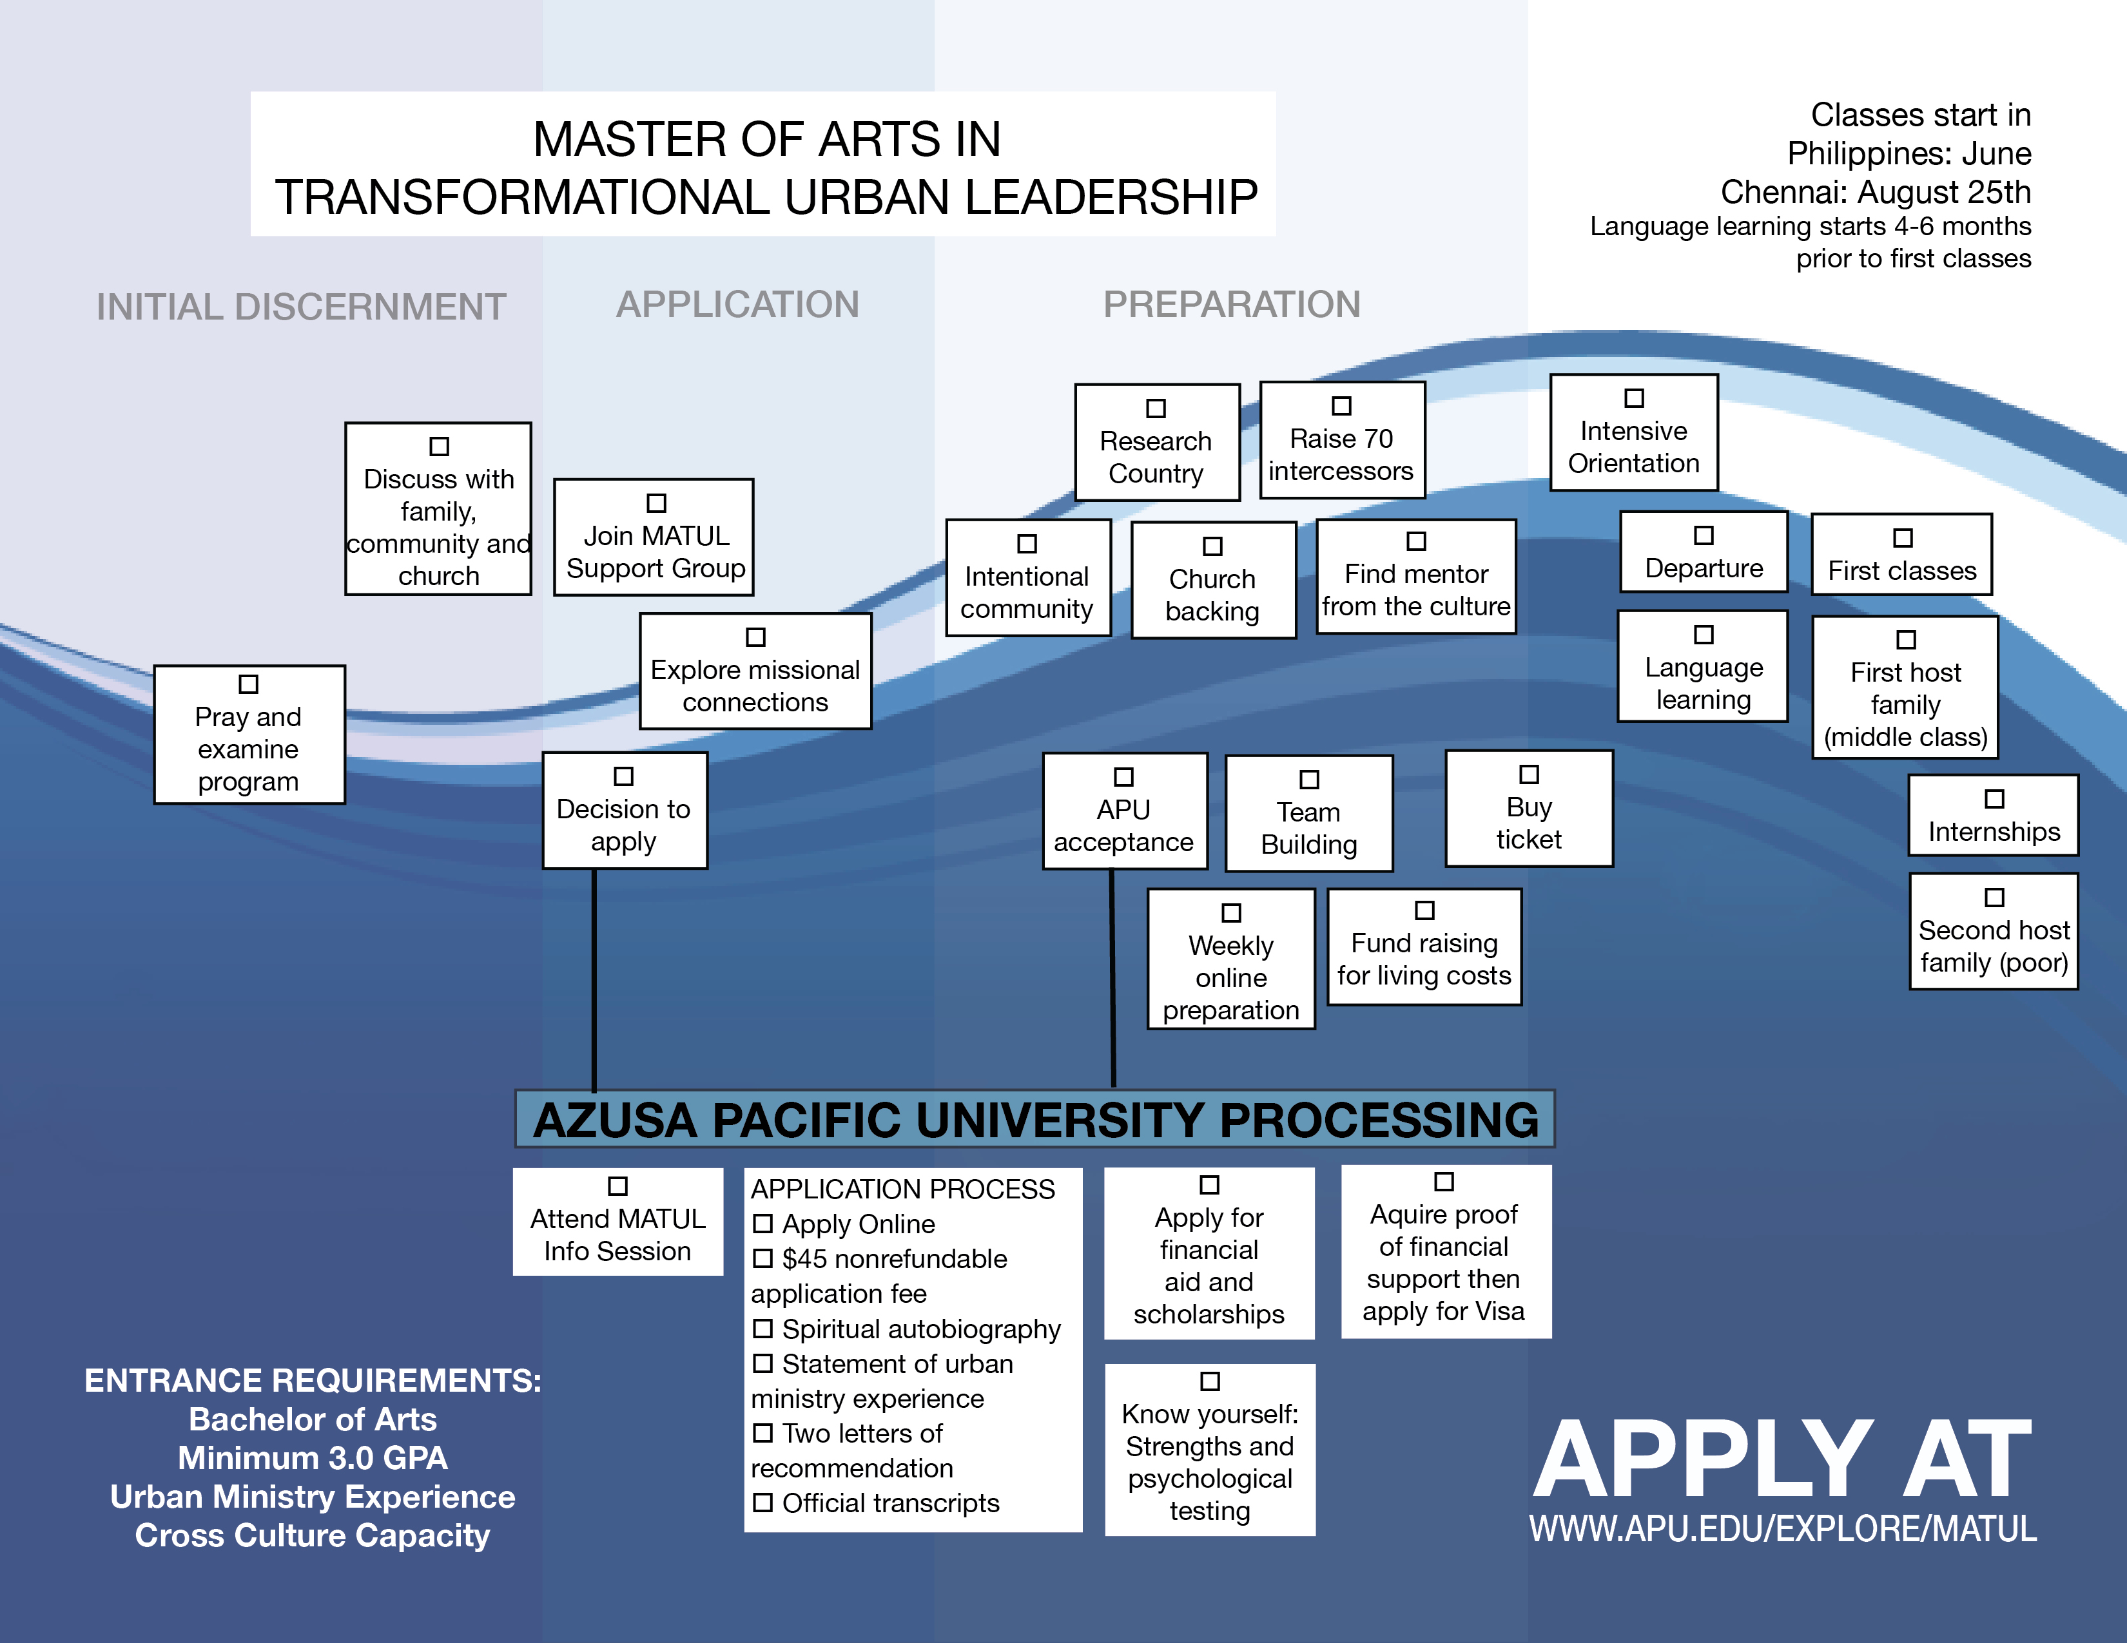
Lalalal

Slide 15
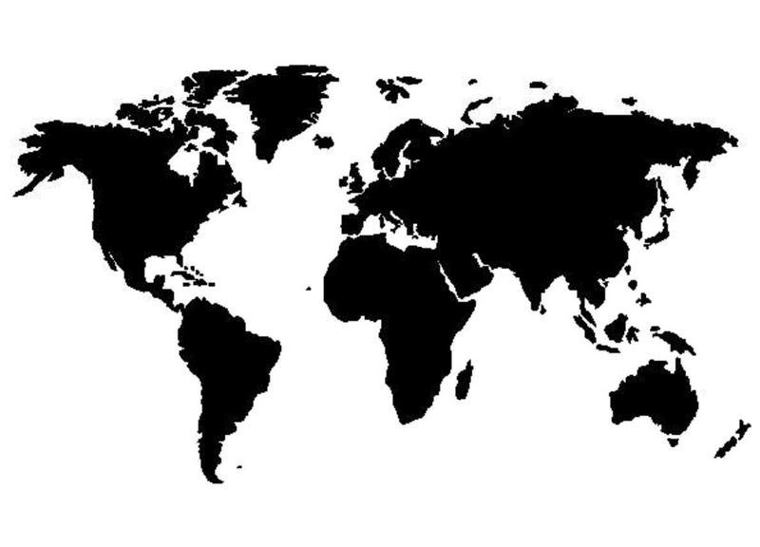

A Global Degree: MATUL Partners
A program in partnership with The Encarnação Alliance, an international network of urban poor leaders and scholars
  Asian Theological Seminary in Manila, began July 2007
  Hindustan Bible Institute in Chennai, India began June 2007
  Azusa Pacific University in Los Angeles began April 2010
  Carlisle College in Nairobi, June 2011
  Mission India, Nagpur, June 2011
  Univeriste Episcopale d’Haiti (in French), Oct 2010
  A web-based process for field-based teams late 2012
  www.urbanleaders.org/ma

Slide 16
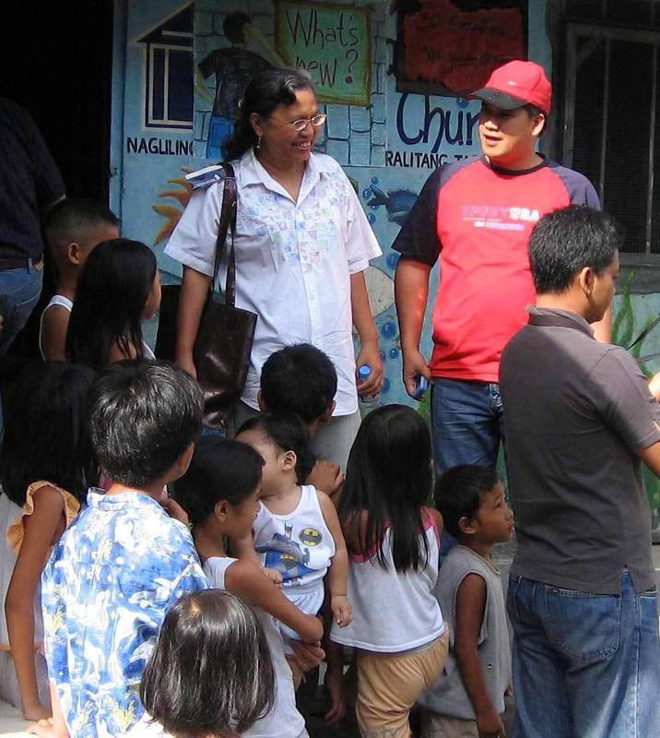
MATUL Leadership
  Encarnação Alliance Coordinator, Dr. Viv Grigg, international director of MATUL at APU,
    lived in the slums of Manila, Calcutta and Sao Paulo. (Get his book, Companion to the Poor for core elements of this program).
  Dr. Corrie DeBoer is the Chair of the Encarnação Alliance Training Commission
    she started 500 slum schools
  Dr. Lee Wanak is Program Director at Asian Theological Seminary in Manila
  Dr. Isac Raja is Principal of HBI in Chennai, , India (he trained 5000 churchplanters). Dr Saravanan directs the program.
  Dr. Rich Slimbach is academic director for Azusa Pacific University in Los Angeles
  Dr Colin Smith trains 50 slum pastors in Nairobi slums each year in a Centre for Urban Mission in the Slums
Corrie and students in Welfareville

Slide 17
How does MATUL differ from other degrees?
An Entirely New Field: Urban Poor Movement Leadership
  A Leadership Degree
  Urban Poor Leadership
    There is no formal training for these leaders globally
MATUL | OTHER DEGREES
Practical Story Telling Theology | Systematic Theology
Prophetic, Apostolic, Entrepreneurial Leadership | MBA Leadership for NGO Mangers
Urban Analysis & Urban Theology | Urban Studies
Church Based Diakonal Development with the Poor | Social Work for the Poor
Grassroots Community Development and Advocacy | International Development focussing on macro-themes

Slide 18
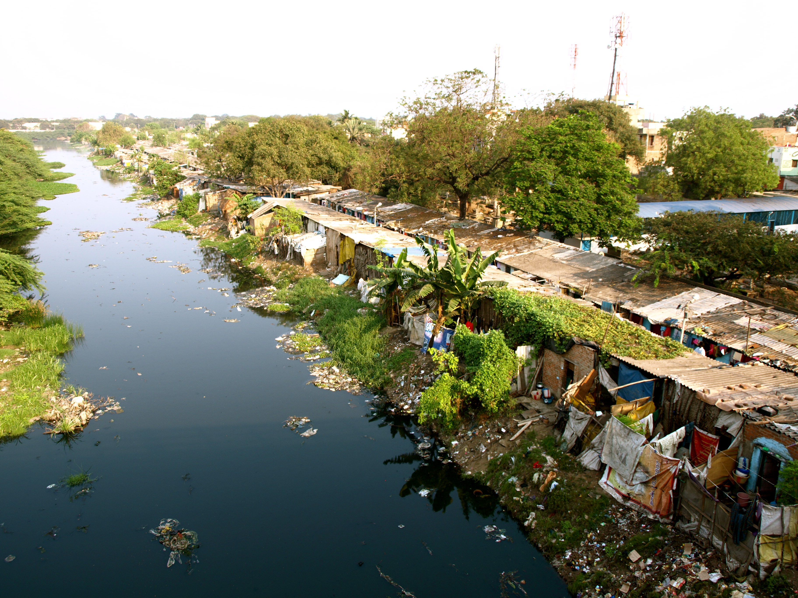
What are the costs for the degree?
APU cost for degree
$340/unit = $15,600
Plus airfares, language school, accommodation
What is the Schedule?
First Class begins downtown LA in Sept
Language Study begins in January
Registration and classes begin in
in the Philippines
in India
in Haiti
in Kenya

Slide 19
A Global Degree: MATUL Partners
A program in partnership with The Encarnação Alliance, an international network of urban poor leaders and scholars
  Asian Theological Seminary in Manila, began July 2007
  Hindustan Bible Institute in Chennai, India began June 2007
  Azusa Pacific University in Los Angeles begin Jan 2011 then online
  Carlisle College in Nairobi, an 2012
  Haiti, Oct 2011??
  Mission India, Nagpur, Sept 2011
  www.matul.org

Slide 20
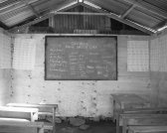
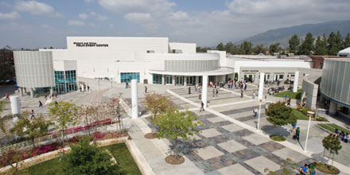

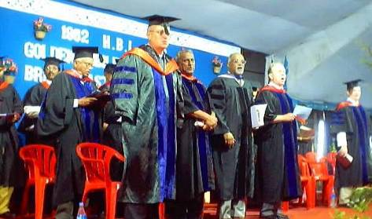
Collaboration in a Global MA in Transformational Urban Leadership
Azusa Pacific University – a resource base
Centre for Urban Mission, Nairobi
Hindustan Bible Institute, Chennai, India
Mission India Training School in Nagpur, India
15 other schools enquiring

Slide 21
MATUL Leadership
  Encarnação Alliance Coordinator, Dr. Viv Grigg, international director of MATUL at APU,
    lived in the slums of Manila, Calcutta and Sao Paulo. (Get his book, Companion to the Poor for core elements of this program).
  Dr. Corrie DeBoer is the Chairperson of the Encarnação Alliance Training Commission
    she started 500 slum schools
  Peter Nistche is Program Director at Asian Theological Seminary in Manila
  Dr. Isac Raja is Principal of HBI in Chennai, , India (he trained 5000 churchplanters). Dr Saravanan directs the program.
  Dr. Rich Slimbach is academic director for Azusa Pacific University in Los Angeles
  Dr Colin Smith trains 50 slum pastors in Nairobi slums each year in a Centre for Urban Mission in the Slums
  Pere Oge Beauvoir directs the program at UNEPH, Port au Prince, Haiti
  Dr Aseervedam directs program at RIMI, Nagpur
Corrie and students in Welfareville

Slide 22
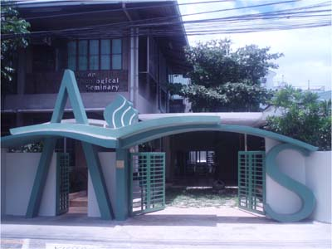
Asian Theological Seminary
Our mission is to glorify God by providing
quality theological education to prepare leaders who will effect biblical transformation in the Church and societies in Asia and beyond.
Campus: 54 Scout Madriñan, Quezon City, Philippines
Mailing Address: QCCPO Box 1454-1154
Quezon City 1102, Philippines
ATS Phone: (632) 928-6717 Loc 125, Fax: (632) 928-5114
Center for Urban Transformation Phone: (632) 928-5097
Program Director: Dr. Lee Wanak/ L_Wanak@yahoo.com
Program Assistant: Nelson Gaurano/ nelson@ats.ph
Chair, Encarnação Alliance Training Commission:
Dr. Corrie DeBoer/ stewcorrie@yahoo.com
General E-mail: info@ats.ph

Slide 23
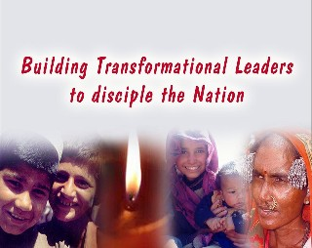
Hindustan Bible Institute
HBI exists…
To give every person an opportunity to hear, understand and respond to the Gospeland to be discipled into communities of believers.
Vision
We want to see a dynamic transformational church in every village and colony of every town and city of India!
Campus: HBI Ministries (India)
86-89 Medavakkam Tank Road
Kilpauk, Chennai 600 010
TamilNadu, India
Phone: 91-44-2642 1199/1975/3664
Fax: 91-44-2642 3664
E-Mail: info@hbionline.org
Principal: Dr Isac Raja Soundaraj, principal@hbionline.org
Program Director: Dr. P.N. Saravanan, pn_saravanan@yahoo.com
Program Assistant: Grace Nithya, grace_nithya@yahoo.com

Slide 24
Asuza Pacific University
This program will be delivered entirely as a field based program at our partner schools overseas
Begins Jan 2011
Contact:
  Dr Viv Grigg, vgrigg@apu.edu
  Dr Rich Slimbach rslimbach@apu.edu
  Or Rebecca Pratt rpratt@apu.edu

Slide 25
Carlile College, Nairobi, Kenya
An Anglican training college. Moved into the slum of 800,000 people, Kibera, and each year has trained 54 pastors. Now developing the MA to launch next Jan 2012

Slide 26
Universite Episcopal d’Haiti
Port au Prince, Haiti, will launch October, 2011. The University collapsed in the earthquake and many students died. They are eager to move ahead.

Slide 27
Mission India Theological Seminary
∧
Nagpur, India,
Will launch MATUL, Sept 2011

Slide 29
How does MATUL differ from other degrees?
An Entirely New Field: Urban Poor Movement Leadership
  A Leadership Degree
    Movement Leadership (evang/apostolic leadership centre) vs Management for NGO ‘s (diaconal centre)
    this is not an MBA
  Urban Poor Leadership (This is an urban degree)
  A Movement Leadership Degree vs a Development Degree
    Why? Theologically - Jesus came to train movement leaders (apostles). Deacons/managers were in support roles
      His style was holistic mission with a centrality of evangelism, not holism based on Western fundraising
      (cf. Valdir Steuernagals reflections at WEA on failure of holism in contrast with holistic mission)
  Urban Poor Leadership
    There is no formal training for these leaders globally

Slide 30
Core Theological Concepts Behind the Degree
  The Kingdom of God as core theological framework
    Holistic church-planting as central vehicle for Kingdom development
  The spiritual is central
    to economic, social and justice Kingdom dimensions
  The Church, the Word, the Spirit are the Primary Agents of Transformation
    International Diaconates are to serve the advance of the incarnational church
  Story-telling
    Is the primary methodological process of doing theology among the poor (though at an MA level meshes with linear Western logic in the integration paper)
  Incarnational
    requires students to relocate to slums for large portions of the degree

Slide 31
With a base in the grassroots training in holistic churchplanting,
in addition at an MA level…
Development of Movement Leadership
  e.g. issues moving from leadership of 6 churches to 30, of small economic or development projects to wider scale processes
Expansion of Theoretical Understandings
  e.g. Understanding City Systems or Structures of Advocacy
Preparation of Cross-cultural Missionaries
  Our major goal is to create structures serving 5,000 leaders who will move 50,000 from the slums to the slums
Expansion of Holistic Elements in Church Formation
  e.g How to get every elder established with a Kingdom economic theology and economic base
Entrepreneurial Development

Slide 32
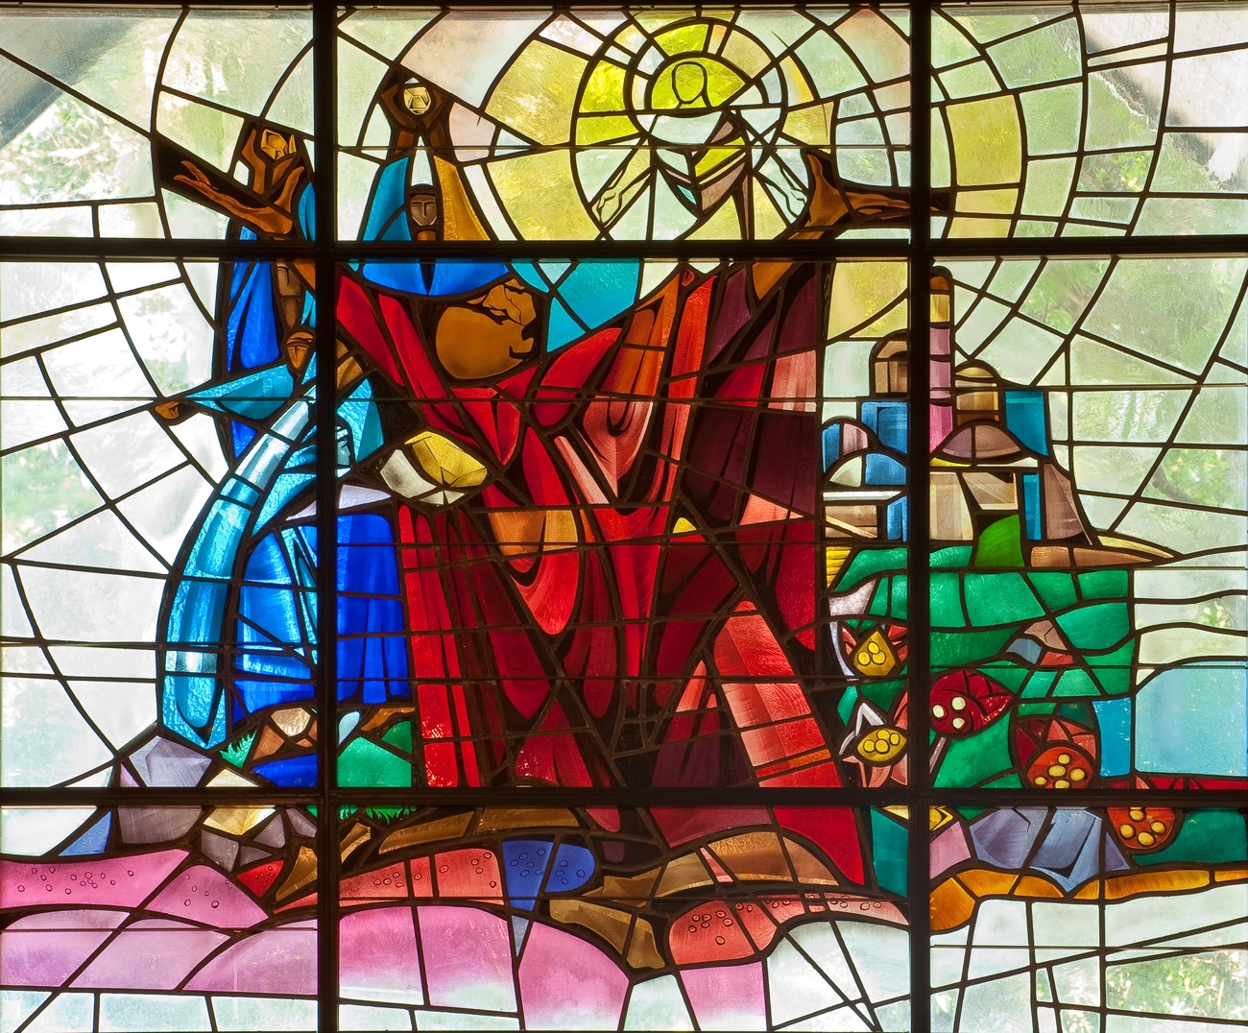

Slide 33
50,000 from the slums to the slums
God is doing this, not us
The Encarnacao Alliance links 400 movement leaders
City Leaders networks train hundreds of grassroots slum pastors – 1198 churches resulted in 3 years
The Encarnacao Alliance MATUL Commission is responsible for establishing slum movement leader training in 5 continents.

